Slide 1
1
بِسْمِ اللهِ الرَّحْمٰنِ الرَّحِيْمِ

Slide 2
TOPIC NAME
2
Spectrum Sensing-Energy Tradeoff in Multi-hop Cluster Based Cooperative Cognitive Radio Networks

Slide 3
Group Members
3
Zain-Ul-Abidin D-17-TE-41
Faheem Ahmed D-17-TE-24
Naveed Ahmed D-17-TE-33
Mohammad D-17-TE-15

Slide 4
Table of Contents
4
Cognitive radio
a)Objectives of Cognitive Radio Networks
b)Problems occurs in CR
c)Working Principle of CR
Energy Detector
a)Working Principle of ED
Cooperative Spectrum Sensing
Clustering
Multi-hop cluster based cooperative spectrum sensing
Calculation
Simulation diagram
Conclusion

Slide 5
Cognitive radio:-
5
Cognitive Radio is an intelligence device that enables a more flexible and efficient usage of the radio spectrum.
Cognitive Radio (CR) is a key enabling technology of DSA that allows sharing the licensed bands in an opportunistic manner.
DSA(dynamic spectrum access) The technology which allow the secondary users to utilize spectrum holes of primary user.

Slide 6
Objectives of Cognitive Radio Networks
Continue…
6
Spectrum sensing - determine the spectrum holes
Spectrum decision - select the best spectrum opportunities to meet the user communication requirements
Spectrum sharing - coordinate access to the selected channels with CR neighbours.
Spectrum mobility - switch to the selected opportunities .

Slide 7
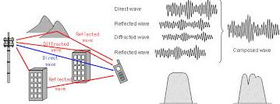
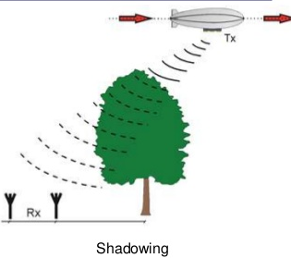
Problems occurs in CR
7
Multipath fading
Shadowing
The receiver uncertainty problem

Slide 8
Energy Detector
8
To measure the performance of the energy detector the following metrics are used
1. The probability of detection (PD)
2. The probability of false alarm (PFA)
3. The probability of missed detection (PM) .

Slide 9
Continue…
9
Energy detector (ED) is a one of the best spectrum sensing technique that does not require prior information about the primary signal. This will give best results at low SNR.
In spectrum the primary user is present when calculated level of incoming energy level is more than threshold energy level.

Slide 10
Working Principle of ED
10
1. The probability of detection (PD)
2. The probability of false alarm (PFA)
3. The probability of missed detection (PM)

Slide 11
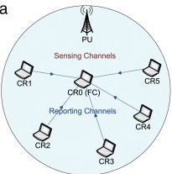
Cooperative Spectrum Sensing:-
11
In order to overcome the issues of cognitive radio fading and shadowing cooperation technique is introduced

Slide 12
Continue…
12
Cooperative spectrum sensing technique is proposed to eliminate the effects of shadowing and multipath fading on the spectrum sensing of primary user.
Multiple CRs having its own decisions to report fusion center(FC)

Slide 13
Problems
13
More power consumption
Additional transmission delay.

Slide 14
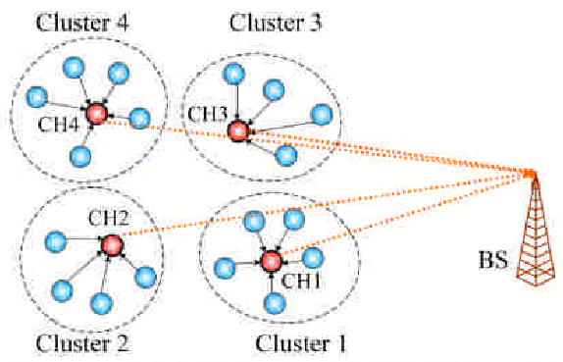
Clustering
14
Clustering is a technique in cooperative spectrum sensing that use censorship strategy where only one user that has reliable information could report the sensing result to fusion centre (FC).

Slide 15
Continue…
15
Cognitive users are grouped into clusters and the user with highest SNR of reporting channel is chosen a cluster head (CH), which in turn sends the cluster decision to FC.

Slide 16
Problems in Clustering
16
Clustering are not energy-efficient.
Due to clusters that are far from the FC
give error reporting.

Slide 17
Multi-hop Clustering
17
CSS Consider a multi-hop clustering cognitive radio network with both identical and non-identical channels.
We assume that there are L hops between primary user and the FC. Each non identical cluster head CHL forwards the cluster results to the next hop cluster head CHL-1 with probability error PE

Slide 18
Multi-hop cluster based cooperative spectrum sensing
18
An algorithm used to overcome the above problem
In multi-hop algorithm, the chs will not send their cluster sensing results directly to the FC as it is in traditional clustering approaches
But they will send them to the nearest next level CHs towards the FC,

Slide 19
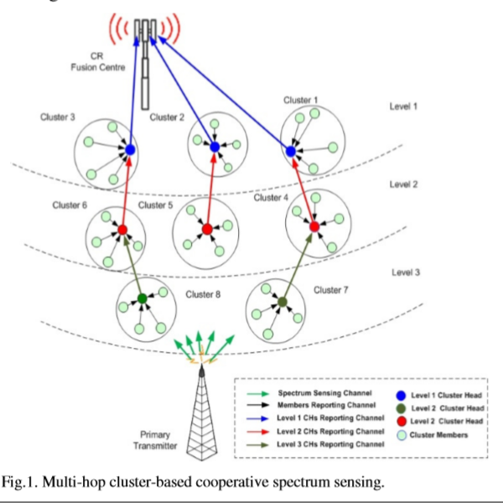
19

Slide 20
Advantages
20
Less power consumption for decision reporting
With reliable transmission channel,
Which leads to accurate spectrum sensing.

Slide 21
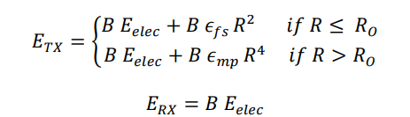
Calculations
21
Energy for MHCBCSS
B= size of message(bits)
Eelec = electronic energy consumed to send or receive a message;
Etx= total energy consumed by the transmitter
Erx= is energy consumed by the receiver
Efs and Emp denote the energy dissipated by the transmit power amplifier
R2= free space path loss
R4= multipath fading loss
R0=threshold distance

Slide 22
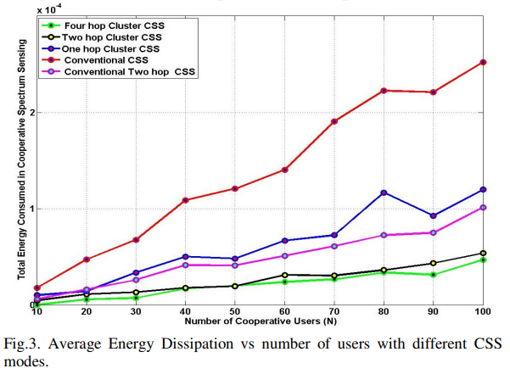
SIMULATION RESULTS
22

Slide 23
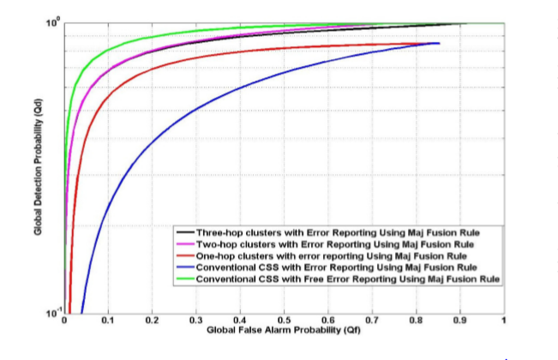
Continue…
23

Slide 24
SIMULATION RESULTS
Continue…
24
52% in one-hop clustering mode compared to the conventional cooperative mode
Two-hop clustering could achieve up to 55% than one hope
Energy saving in 4-hop is 12.6% more than 2-hop mode

Slide 25
CONCLUSION
25
In this paper, we have proposed a new multi-hop clustering approach for cooperative spectrum sensing. Based on our simulation results, the performance of the proposed algorithm has been evaluated through twoassessment points, including sensing performanceand the energy consumption.
transmission energy consumption of our proposed scheme has been derived and compared with that of the conventional one including direct reporting and 2-hop reporting schemes.

